Slide 1




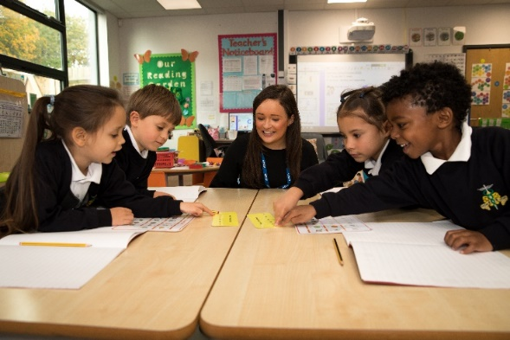
Mr Tofallis
Head Teacher
October 2024
‘Excellence, Aspiration and Care.’
‘Excellence is a habit.’

Slide 2

Senior Leadership Team:
Miss Costas - Deputy Head Teacher, Key Stage One and Two Lead.
Mrs Toal – Assistant Head Teacher, SENCO, Key Stage One and Two Lead.

Slide 3
Leadership Team:
Miss Powell - Early Years and PE Lead.
Mrs Leo – Maths Lead.
Mrs Macdonald and Mr Bonallo – English Leads.

Slide 4
Teachers:
Reception Class Teacher - Miss Powell
Reception Class Teacher – Miss Burke
Year One Class Teacher – Miss Popova
Year One Class Teacher – Miss Linden
Year Two Class Teacher – Mrs Joyce and Mrs Bennett
Year Two Class Teacher – Miss Sudo
Year Three Class Teacher – Mrs Pavlou
Year Three Class Teacher – Mrs Beth
Year Four Class Teacher – Miss Muse
Year Four Class Teacher – Mrs Leo
Year Five Class Teacher – Mrs Kamal Uddin
Year Five Class Teacher – Miss Macdonald
Year Six Class Teacher – Mr Evaghoras
Year Six Class Teacher – Mr Bonallo
Staff:
HLTAs, TAs, School Direct Teachers, Office, Welfare, Play Leaders, Lunch staff, Breakfast and After School Club, Cleaners and Caretakers.

Slide 5
Our Staff in Reception
Calypso Class Teacher: Miss Powell – EYFS Lead
School Direct Teacher: Mrs McClymont
SEN Teaching Assistant: Mrs Ahmet
Orion Class Teacher: Miss Burke
Teaching Assistant: Mrs Tibbs
SEN Teaching Assistant: Mrs Ramdarshan

Slide 6
Ashmole Trust
Ashmole Academy Trust was formed in 2015 as a Multi Academy Trust.
Its ambition is to create an outstanding educational campus providing education from the ages of 4 through to 19.
Its motto is ‘Excellence, Aspiration and Care’ which reflects its determination to achieve the very best in terms of educational standards in all its schools.

Slide 7
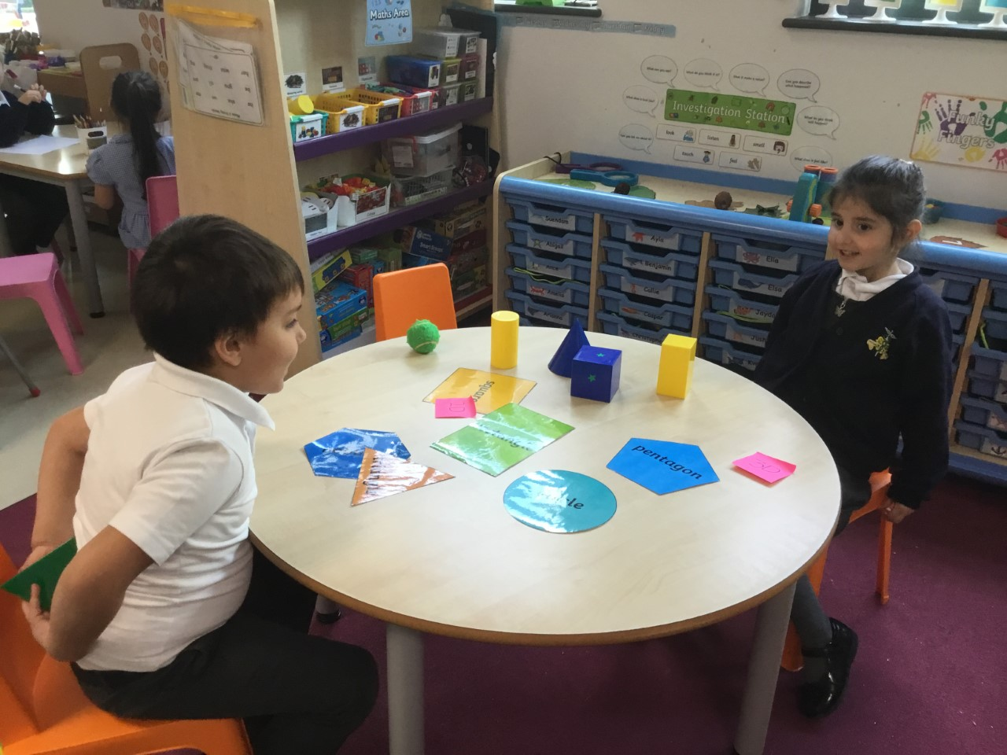
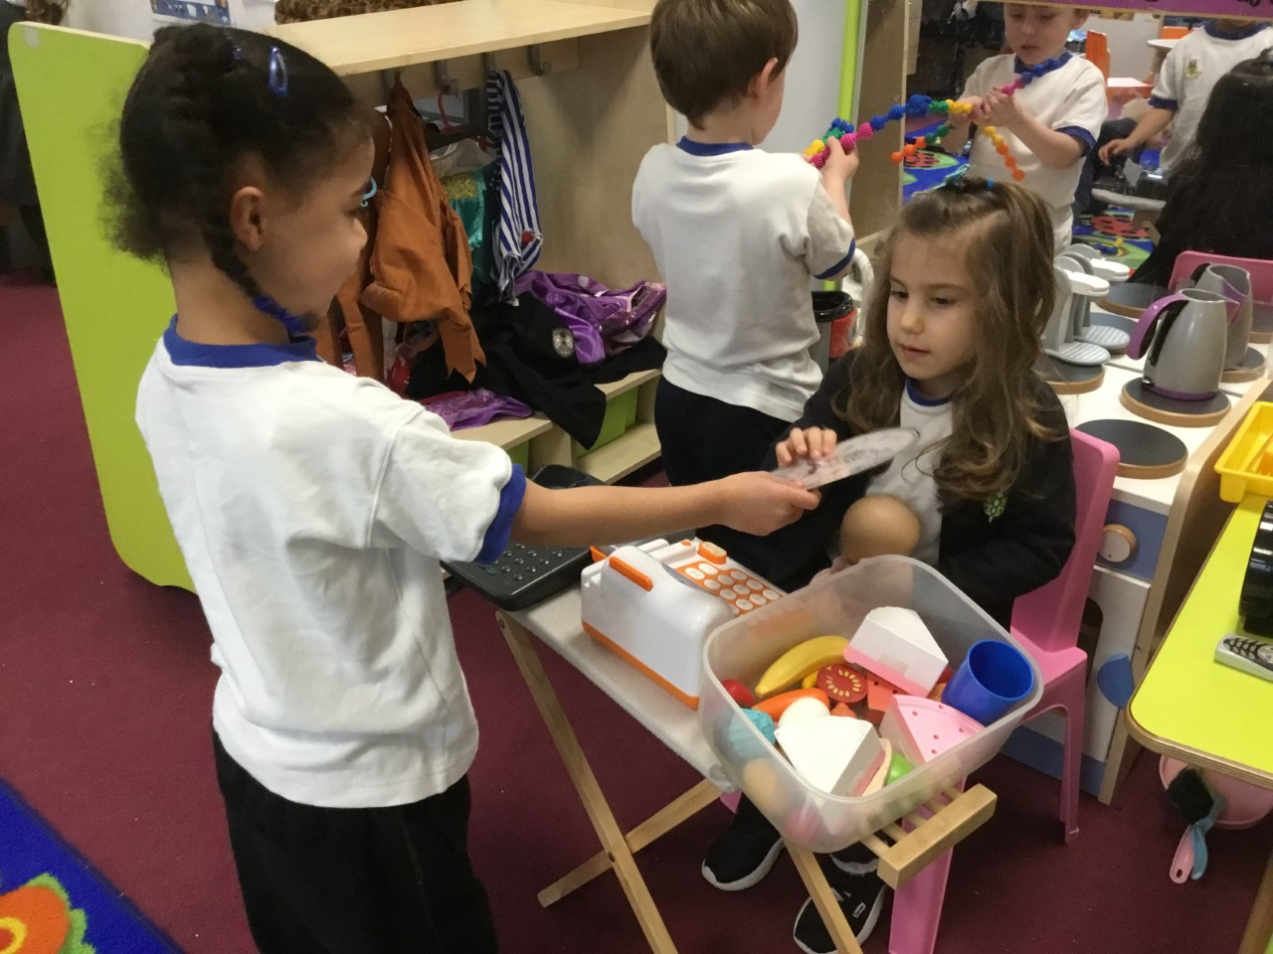
Creating a Safe
and Inclusive Environment.
‘Excellence, Aspiration and Care.’
Ashmole Primary is committed to the safety and wellbeing of all our pupils and staff.

Slide 8
Vision
‘Excellence, Aspiration and Care.’
At Ashmole Primary we want all children to enjoy school and have a love of learning. We encourage them to persevere, to have self-belief and the determination to succeed in all they do in order to be the best that they can be.
Our school benefits from being able to share facilities with the Secondary School.
We are a feeder school to the Academy.
Part of the Ashmole Trust (Academy, Primary and Osidge).

Slide 9
At Ashmole Primary School we expect pupils to:
Be kind, helpful, respectful and polite.
Always try our best.
Be proud to be ourselves.
Treat others as we would like to be treated.
Have fun!

Slide 10

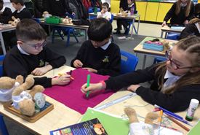
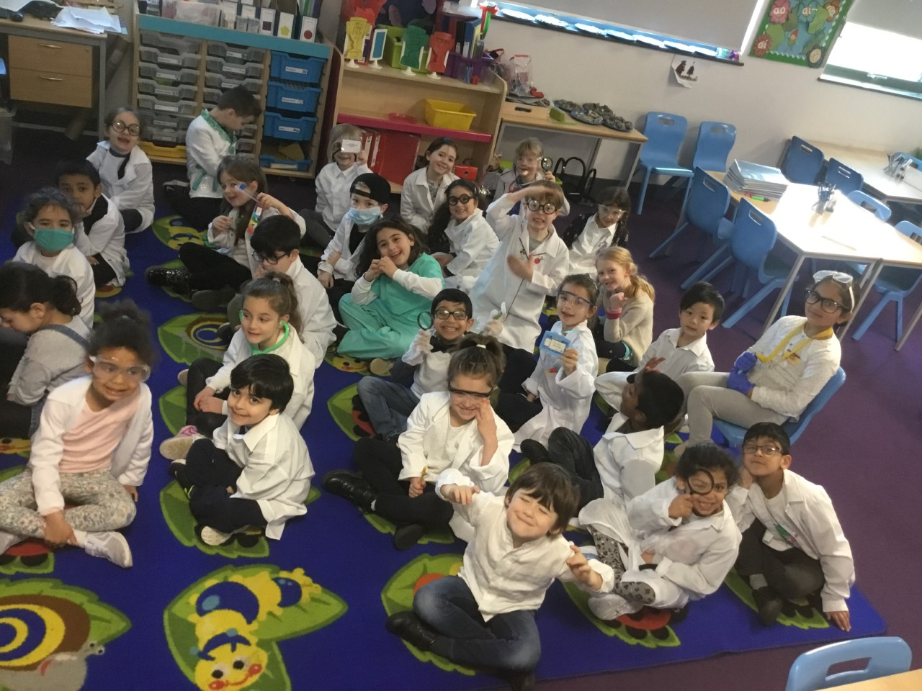
Outstanding Behaviour
A Values Education School with monthly Values.
Merit assemblies every Friday for all the children.
House Points.
We aim to be independent.
We share feelings and worries.
We use Class, Playground and Online Charters.
We use positive praise.

Slide 11
‘An Outstanding School’ – Ofsted
◼ Leaders, governors and staff share an ambitious vision for every child and pupil to excel in their education, and to enjoy learning.
◼ Children achieve exceptional outcomes at school.
◼ The proportion of children achieving a good level of development at the end of Reception is significantly above the national average. This is also the case for the phonics screening check in Year 1 and with our SATS results.
◼ Pupils make excellent and strong progress from their different starting points.
◼ The quality of teaching and learning is outstanding. Care and attention is paid to pupils’ spiritual and pastoral needs, as well as to their academic development.

Slide 12
‘An Outstanding School’ – Ofsted
◼ Staff are proud to work at the school. They value the high level of professional development they receive.
◼ The curriculum is broad and it is delivered in a way that engages all pupils.
◼ Pupils love coming to school and rarely miss a day. Attendance is above the national average. Pupils’ behaviour is excellent.
◼ The Early Years provision is outstanding. Children receive high-quality learning experiences in the classroom and in the outdoor learning space.
◼ Parents are overwhelmingly happy with the quality of education their children receive, and with the communication from the staff. Parents make a significant contribution to the life of the school.
◼ Safeguarding is very effective. Governors and all our staff are trained well to keep pupils safe.

Slide 13
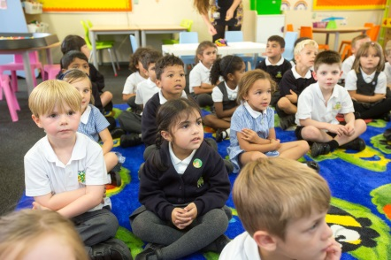
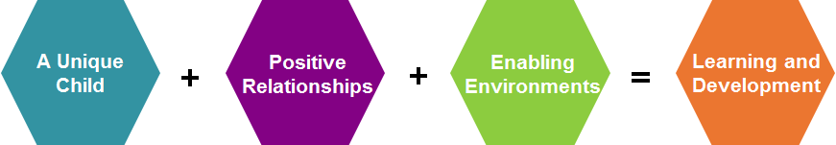
EARLY YEARS FOUNDATION STAGE
To encourage each child to achieve their full potential, to give them the confidence to succeed, to provide a happy, secure and safe environment in which to learn and to celebrate their achievements in all areas.
We will set realistic and challenging expectations that meet the needs of all the children.
We value the diversity of everybody within the school.
Positive relationships for all- encouraging independence.
A highly stimulating environment, rich, varied and cross
curricular with imaginative experiences for all pupils. Excellent role play
with resources inside and out of the classroom.
A child becomes an effective motivated learner through playing and exploring, active learning, creating and thinking critically.

Slide 14

Seven Areas of Learning
Understanding the world
Expressive Arts & Design
Literacy
Mathematics
Communication and Language
Personal, Social & Emotional development
Physical Development
In each area there are Early Learning Goals for the children to reach by the end of Reception.

Slide 15

Routines include:
Reception admission is over three weeks in September 2024.
Times: 8.50am - 3.20pm.
Sessions are a balance of Child Initiated Play and Adult
Directed Activities (inside and outside the classroom).
Fine motor activities.
Phonics, writing and number skills.
Snack time. Lunch is at 11.30am-12.30pm. Children play in the EYFS outdoor area.
Stories and Rhymes.
Reading.
PE.
Celebration Merit Assemblies every Friday.
Developing self esteem and confidence.
Spanish lessons from the Spring term.

Slide 16
Assessment
Observations of each child at least once a week. Monitoring of Child Initiated Play observing engagement, motivation, thinking, age range and ‘what next opportunities’.
Weekly focus children.
Quality Learning journals that are personal to each child and will help us to monitor progress and plan future activities.
Termly consultations with a school report in July.
Baseline in Autumn 1 & end of Reception profile in July.
(emerging or expected)
High rates of progress and outstanding achievement.

Slide 17
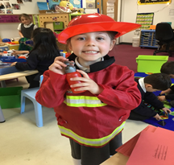
Staying in touch
Half-termly curriculum letters and updates.
School newsletters.
Focus week update meetings.
Consultations & reports.
Sharing of special moments and achievements.
Parent comment sheets.
Home/ school records.
Email/ text service.
‘Open door’.

Slide 18
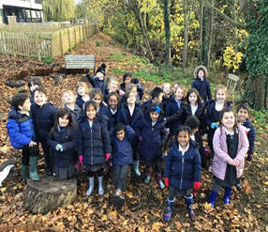
KEY STAGE ONE CURRICULUM
English * Reading- Individual and Guided Reading, Phonics, Writing, Grammar and Speaking and Listening
Mathematics * Mastery, Fluency, Problem Solving and reasoning skills
Science
Computing
Humanities (History, Geography)
Art and Design
Design Technology
Music – Academy links
Physical Education (Games, Gymnastics, Dance)
RE and PSHE
Spanish - Academy links
Day trips
Lunch is at 12.00pm-1.00pm.
* Themed Days across the school during the year. Links with the secondary school.
8.50am-3.20pm

Slide 19
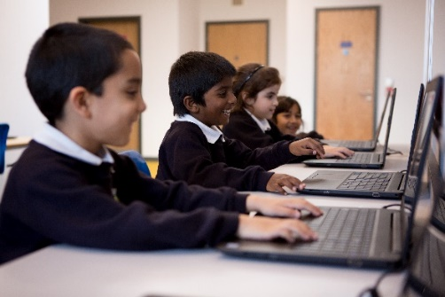
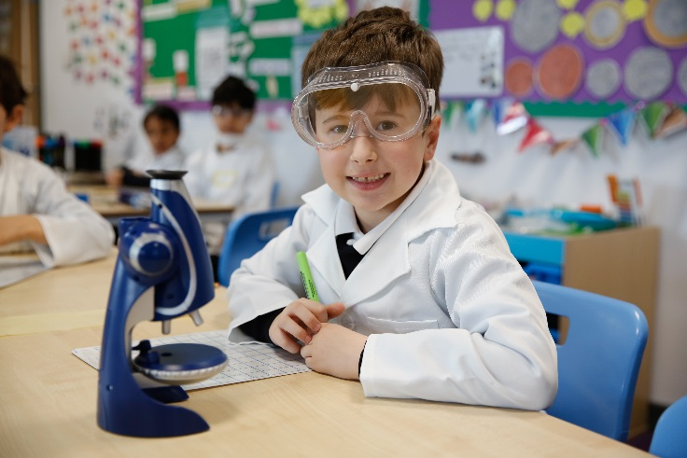

KEY STAGE TWO CURRICULUM
English * Reading- Individual and whole class guided Reading, Writing, Spellings, Grammar, Speaking and Listening
Mathematics * Mastery, Fluency, Problem Solving, Reasoning and Times tables focus in Y3/4
Science
Computing
Humanities (History, Geography)
Art and Design
Design Technology
Music – Academy links
Physical Education - Games, Gymnastics, Dance (and Swimming- eg. in Year 5) – Academy links
Residential trips – eg. Years 4, 5 and 6
Spanish – Academy links
RE and PSHE
Lunch is at 12.30pm-1.30pm.
*Y6/ Y7 Transition programme.
8.50am-3.30pm
Links with the secondary school.

Slide 20

Online Learning
The school is set up on Google Classroom so that teachers can set homework on this platform.
Our website is:
www.ashmoleprimary.org

Slide 21
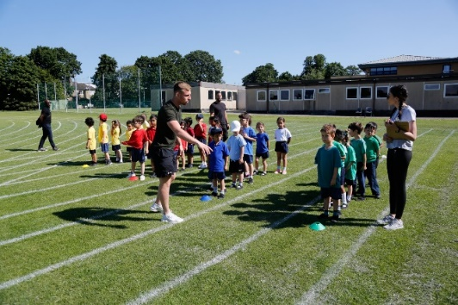
Clubs and Lettings
Breakfast Club
Mon-Fri 7.45am-8.50am £6.25
After School Club
Mon-Fri 3.15pm-5.45pm £12.50
Tennis, Football, Netball, Basketball and Multi Sports
Street Dance and Gymnastics
Languages, Choir and Music
Art Club.

Slide 22
Ashmole Primary Results
Reception | Good Level of Development | National average - 67%
2018 | 85%
2019 | 83%
2022 2023 2024 | 83% 83% 80%
Year 1 | Phonics Screening Check | National average - 79%
2018 | 98%
2019 2020 2022 2023 2024 | 93% 93% 93% 95% 98%

Slide 23
Ashmole Primary Results
Year 6 2024 Subject | Expected + | Exceeding | National Average Expected + | National Average Exceeding
Reading | 95% | 55% | 73% | 29%
Writing GPS | 95% 95% | 45% 75% | 71% 72% | 13% 30%
Maths | 98% | 55% | 73% | 24%
Science | 95% | 48% | 80% | -
Reading, Writing and Maths Combined | 93% | 33% | 60% | 8%

Slide 24


Ashmole Primary Results
We should all be very proud of our school results over all the years we have been here at Ashmole.
In the ‘School Guide’ - Ashmole Primary School came 192nd in the whole country out of all the 16,784 primary schools. This is a ranking within the Top 1.1% in the whole country! This includes all state and private schools. In 2023, 90% of our Year 6 children met the expected standard in Reading, Writing and Maths. In 2023, 23% of our pupils achieved greater depth in all these areas.
In the ‘Telegraph’ Ashmole Primary School came 236th in the whole country out of 15,726 state primary schools. The children in Year 6 (2023) achieved an overall score of 110.3 average score points in Year 6 for Reading, Writing and Maths. 90% of the children met the standard. This is a ranking within the Top 1.5% in the whole country!

Slide 25
Pupil responsibilities and monitors
School Council
Eco Warriors
Healthy Eating
Playground Buddies
Online Safety Buddies
Monitors in class
Library

Slide 26

◼ Leaders and teachers should ensure that all pupils routinely have opportunities to extend their writing skills across the curriculum.
(To always continue to build on this in all year groups throughout the year.)

Slide 27
Recent Reviews:
◼ Continue to promote reading across the school.
◼ Build on Science Vocabulary.
◼ Continue to build pupil awareness of Chronology (Humanities).
◼ Continue to build on Open Ended Questions in Maths.

Slide 28
Subject Leaders - September 2024
Subject/ Area | Leader
EYFS | Miss Powell
KS1 | Miss Costas and Mrs Toal
KS2 | Mrs Toal and Miss Costas
PE/ Lunchtime and Playtime equipment Swimming | Miss Powell
Humanities | Miss Popova
Music | Miss Burke
RE | Mrs Joyce
Science | Mr Evaghoras
Spanish | Miss Linden
Art/ DT | Mrs Kamal Uddin
English and Library | Miss Macdonald and Mr Bonallo
Maths | Mrs Leo

Slide 29
Subject Leaders - September 2024
Subject/ Area | Leader
PSHE | Mrs Pavlou
SEN | Mrs Toal
Staff Wellbeing | Mr Tofallis Miss Costas Miss Popova
Computing | Mrs Bennett Mr Hustyn
BASC and Clubs | Mrs Urdo Baiarda
Buildings | Mr Tofallis Mrs Sidarenou Mr Loizou
Pupil Premium Pupils 24/25 | Class Teachers Mrs Toal
PLAC 24/25 | Class Teachers Mrs Toal
Grounds | Mr Tofallis Mrs Sidarenou Mr Loizou
Office Admin Supplies | Mrs Andrews

Slide 30

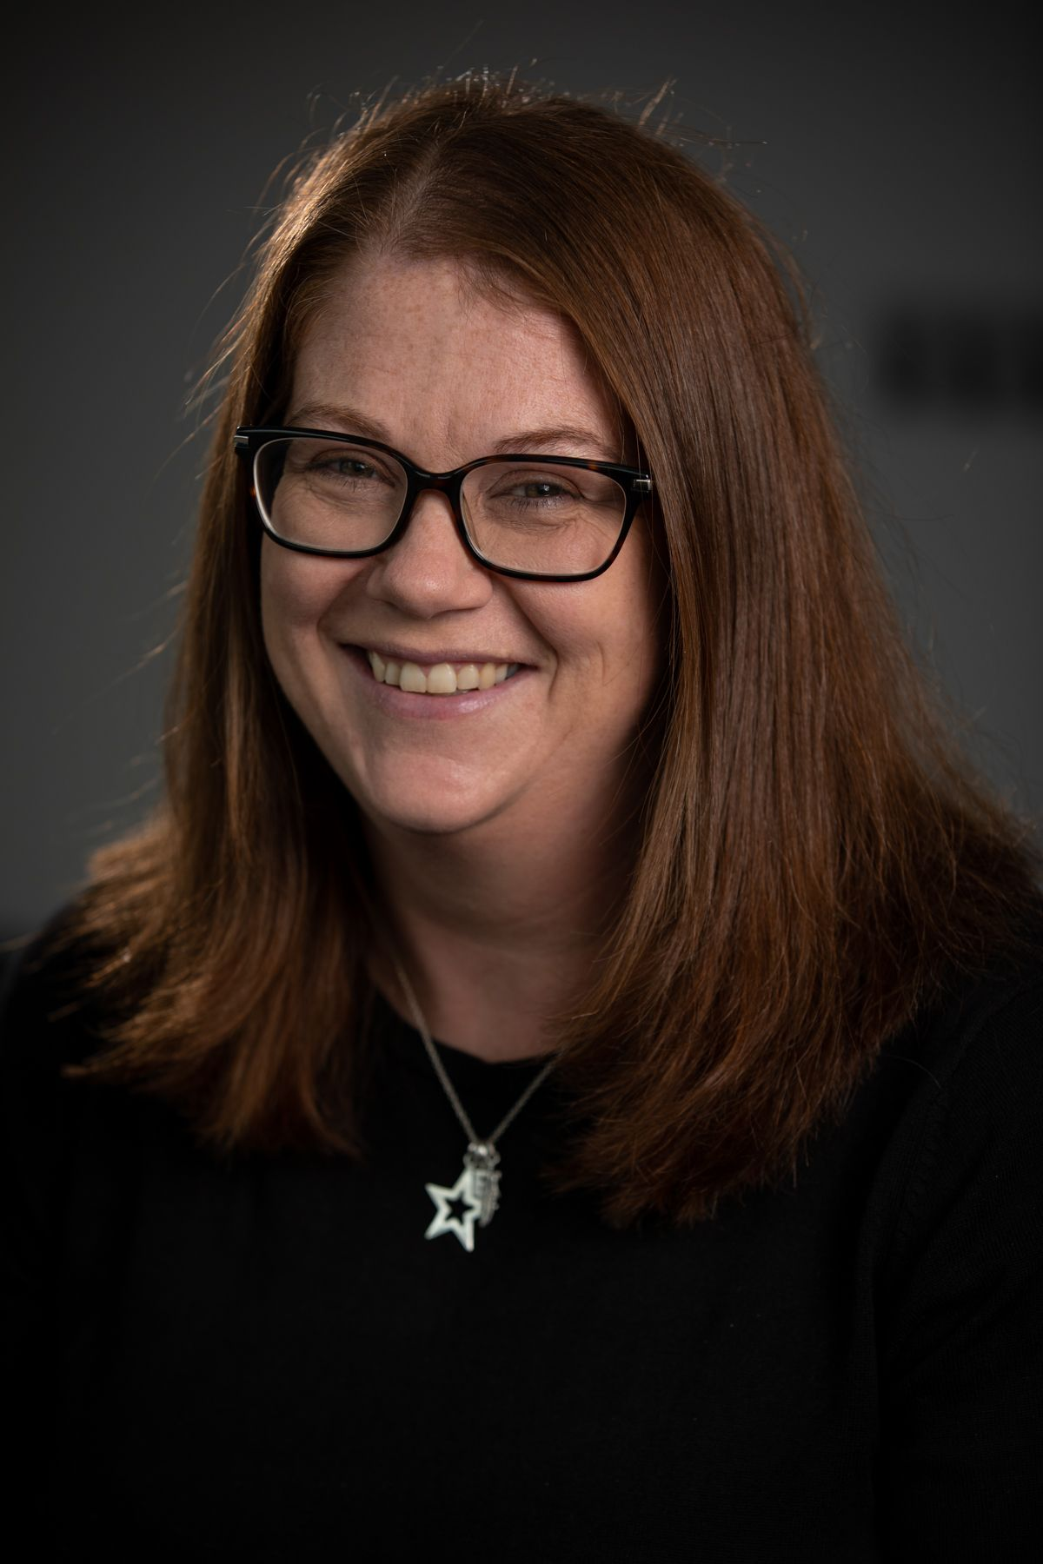
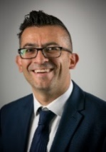
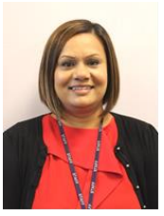
Safeguarding Statement
Ashmole Primary is committed to safeguarding and promoting the welfare of children and expects all staff to share this commitment. The health and safety of all children is paramount. As a school, we will take all reasonable action to ensure the safety and wellbeing of our pupils. In cases where the school has reason to be concerned that a child may be subject to ill treatment, neglect or other forms of abuse, staff must follow the school’s Safeguarding Policy, which is in line with the DFE Keeping Children Safe In Education, and inform Children’s Social Care Services of their concerns.
Safeguarding Team
Miss Costas - Designated Safeguarding Lead
Mrs McLaren – Trust Safeguarding Lead
Mrs Toal and Mr Tofallis – Deputy Safeguarding Officers
Creating a Safe
and Inclusive Environment.

Slide 31
APPTA
Important events organised each year:
Autumn - Winter Fair
Spring – Class events/ e.g. Quiz Evening
Summer – Summer Fair
Raising money for classes and organising socials.
Portacabins now in place for Music and group work.

Slide 32
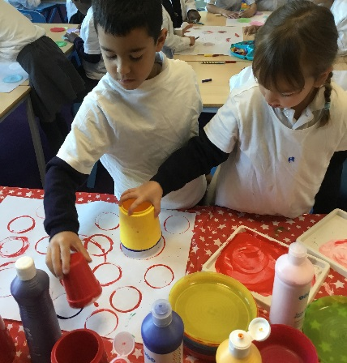
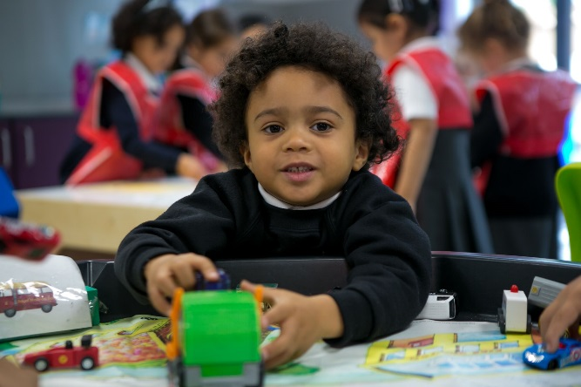
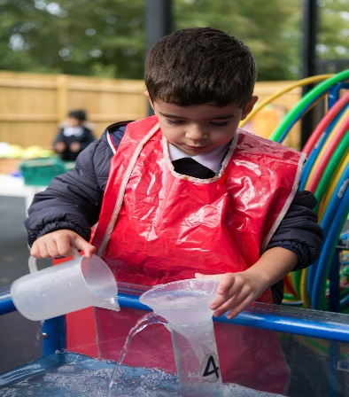
Admissions Policy
www.eadmissions.org.uk
The deadline for applications will be 15th January 2025.

Slide 33
Thank you for visiting Ashmole Primary School.
Best wishes.

